Slide 1

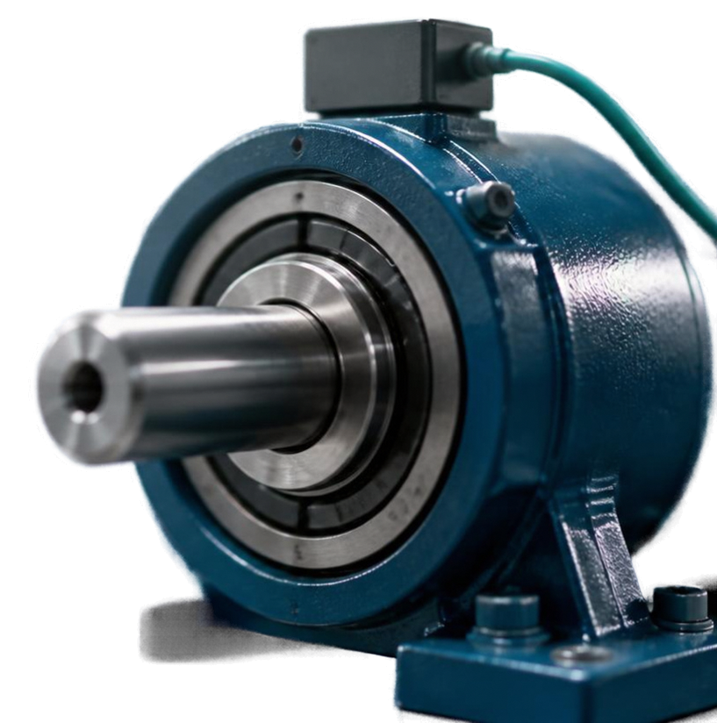

Machine
Failure Detection
Classify failures from operating data
Yan Myoe Naing
6 October 2026

Slide 2

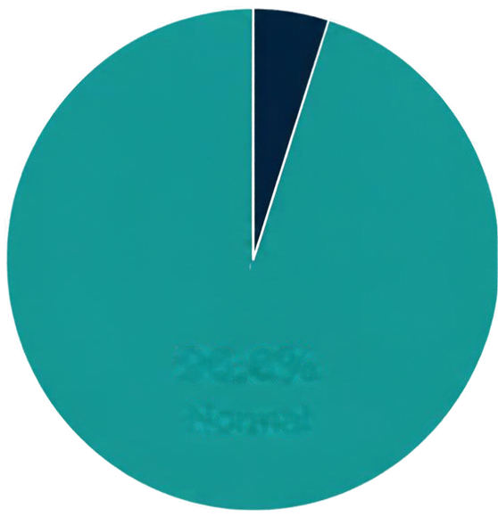

Dataset Overview
3.4%
Failure
20,000 rows
9 original columns
Class distribution
96.6% normal, 3.4% failure
Predictors include
96.6%
Quality, ambient temperature, process temperature, rotation speed, torque, tool wear
Normal
Excluded from modeling
Class distribution
Unique ID, Product ID

Slide 3



Data Exploration
Key exploratory data insights.
991, 400, 1,188
Missing values in quality, process temperature,
and rotation speed.
+0.87
Ambient and process temperature are positively correlated.
-0.87
Rotation speed and torque are negatively correlated.
+0.19 / +0.11
Torque and tool wear show weak positive correlation with the target.
These findings show associations in the data.
No causal claims are made.

Slide 4




Data Preparation
Cleaned and prepared for modelling
Quality imputed by mode and encoded as ordinal values
Process temperature forward-filled by row order
Rotation speed mean-imputed
16,000 training rows | 4,000 test rows
80/20 stratified split
Scaling and 2-component PCA explored for baseline models
Ensembles use original or subset predictors (exclude Quality optionally); no PCA inputs
Imputation used the full dataset before splitting. Fit it on training data instead.

Slide 5



Baseline
Evaluation
Majority-class dummy classifier
96.6%
0
0
accuracy
failure recall
F1 score
0/136 test failures detected
Accuracy alone is not enough.
We prioritise failure recall
and F1 for this project.

Slide 6















Model Comparison
Model
Precision
Recall
F1
Dummy
0.00%
0.00%
0.000
Logistic Regression
0.00%
0.00%
0.000
Decision Tree
88.73%
46.32%
0.609
Naive Bayes
30.34%
19.85%
0.240
Random Forest
99.07%
78.68%
0.877
Gradient Boosting with Quality
99.08%
79.41%
0.882
Gradient Boosting without Quality
98.20%
80.15%
0.883
Source: supplied notebook saved outputs.

Slide 7



Optuna Hyperparameter Tuning
Gradient Boosting without Quality
50
trials with stratified shuffled 5-fold crossValidation
on training data
Objective
maximise F1 score
Best CV F1
Best parameters
0.88435
nEstimators
learning_rate
max_depth
min Samples_split
min Samples leaf
subsample
max_features
493
0.10478
10
3
7
0.76092
None
CrossValidation results above. Final performance reported on test data.

Slide 8





Selected Model Performance
Test set results for tuned Gradient Boosting without Quality.
Predicted
99.60%
Accuracy
Normal
Failure
Normal
3860
4
96.88%
Precision
Actual
Failure
12
124
91.18%
Recall
Detects 124/136 failures
0.93939
F1 score
Misses 12 failures
4 false alarms
Source: supplied notebook saved outputs.

Slide 9



















Recorded Trade-offs
Comparison of key recorded tuning runs on the same task.
Run
F1
Recall
Precision
Tuned with Quality
0.94253
90.44%
98.40%
Selected tuned without Quality
0.93939
91.18%
96.88%
Recall-focused
without Quality
0.91538
87.50%
95.97%
Removing Quality slightly improves recall but lowers F1.
Note: With-Quality run uses different manual settings, not same Optuna tuning.
These are recorded runs, not a controlled experiment.

Slide 10




Conclusion and Limitations
Promising results need further validation
Fit imputation within training and CV folds
Justify forward-fill row ordering
Reserve a fresh final test set
Check reproducibility across training seeds
Evaluation limits
No claim of fully preventing leakage or proving model stability
Cross-validated F1 does not equal test F1
Built with
Python, pandas, NumPy, scikit-learn, Optuna, Matplotlib, Seaborn

